Slide 1
Wireless Network: Introduction
Wireless communication involves the transmission of information over a distance without the help of wires, cables or any other forms of electrical conductors.

Slide 2
Features of Wireless Communication
The transmitted distance can be anywhere between a few meters (for example, a television's remote control) and thousands of kilometers (for example, radio communication).
Wireless communication can be used for cellular telephony, wireless access to the internet, wireless home networking, and so on.

Slide 3
Wireless - Advantages
Cost effectiveness
Flexibility
Convenience
Accessibility
Constant connectivity

Slide 4
Wireless protocols
Wi-Fi
Wi-Fi direct
Zigbee (IEEE 802.15.4)
Z wave ( Generally used in Home Automation)
Bluetooth
RF
6LowPAN
GPRS/3G/LTE
NFC (Near Field Communication)

Slide 5
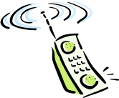

Elements of a wireless network
wireless hosts
laptop, PDA, IP phone
run applications
may be stationary (non-mobile) or mobile
  wireless does not always mean mobility
network
infrastructure

Slide 6
Elements of a wireless network
base station
typically connected to wired network
relay - responsible for sending packets between wired network and wireless host(s) in its “area”
  e.g., cell towers, 802.11 access points
network
infrastructure

Slide 7
Elements of a wireless network
wireless link
typically used to connect mobile(s) to base station
also used as backbone link
multiple access protocol coordinates link access
various data rates, transmission distance
network
infrastructure

Slide 8
Elements of a wireless network
infrastructure mode
base station connects mobiles into wired network
handoff: mobile changes base station providing connection into wired network
network
infrastructure

Slide 9
Elements of a wireless network
ad hoc mode
no base stations
nodes can only transmit to other nodes within link coverage
nodes organize themselves into a network: route among themselves

Slide 10
Wireless network taxonomy
single hop
multiple hops
host connects to
base station (WiFi,
WiMAX, cellular)
which connects to
larger Internet
host may have to
relay through several
wireless nodes to
connect to larger
Internet: mesh net
infrastructure
(e.g., APs)
no base station, no
connection to larger
Internet. May have to
relay to reach other
a given wireless node
MANET, VANET
no
infrastructure
no base station, no
connection to larger
Internet (Bluetooth,
ad hoc nets)

Slide 11
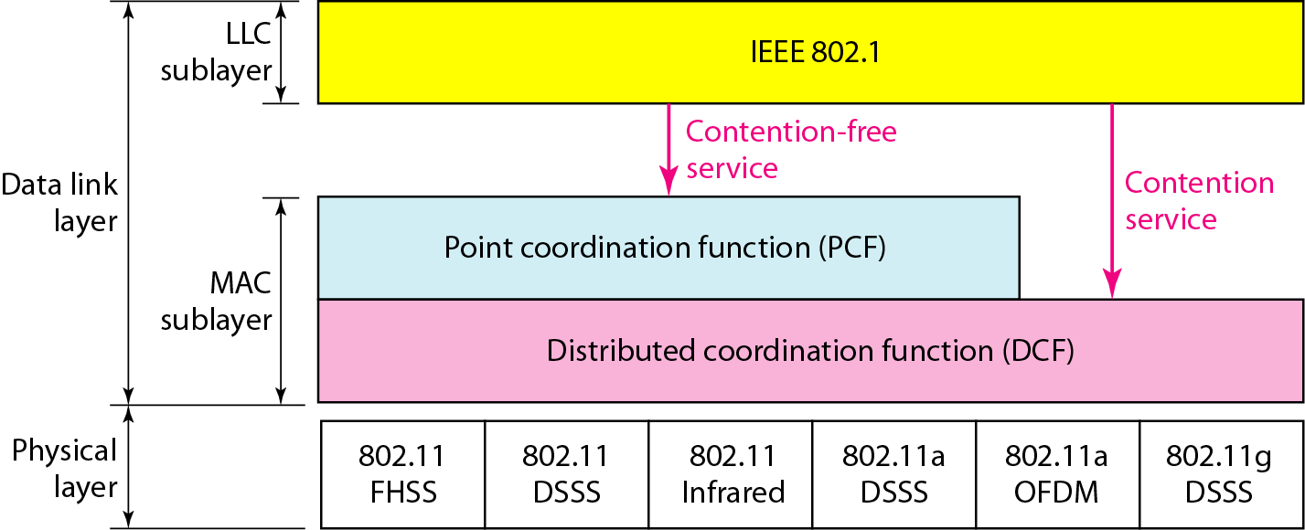
Figure 14.3 MAC layers in IEEE 802.11 standard
FHSS - frequency hopping spread spectrum
DSSS - direct sequence spread spectrum
OFDM - orthogonal frequency division multiplexing
14.<number>

Slide 12
WLAN Standards
802.11 Release Freq Typ Throughput Max Net Bitrate Mod
---- 1997 2.4 GHz 0.9 Mbps 2 IR/FHSS/DSSS
a 2003 5 23 54 OFDM
b 1999 2.4 4.3 11 DSSS
g 2003 2.4 19 54 OFDM
n 2009 2.4 / 5 74 600 OFDM
14.<number>

Slide 13
802.11 n (Wi-Fi-4)
The first standard to specify MIMO, 802.11n was approved in October 2009 and allows for usage in two frequencies - 2.4GHz and 5GHz, with speeds up to 600Mbps.
802.11 ac (Wi-Fi-5)
Current home wireless routers are likely 802.1ac-compliant, and operate in the 5 GHz frequency space. With Multiple Input, Multiple Output (MIMO) – multiple antennas on sending and receiving devices to reduce error and boost speed – this standard supports data rates up to 3.46Gbps.
14.<number>

Slide 14
802.11ax (Wi-Fi 6)
Known as High Efficiency WLAN, 802.11ax aims to improve the performance in WLAN deployments in dense scenarios, such as sports stadiums and airports, while still operating in the 2.4GHz and 5GHz spectrum.
The group is targeting at least a 4X improvement in throughput compared to 802.11n and 802.11ac., through more efficient spectrum utilization. Approval is estimated to be in July 2019.
14.<number>

Slide 15
Creating WLAN Connections
An Access Point (AP) broadcasts is SSID (service set identifier) roughly every 100 ms and at 1 Mbps (to accommodate the slowest client)
The Wi-Fi standard leaves connection criteria open to the client (?)
The Wi-Fi spectrum is divided into a fixed number of channels
  11 in North America
  13 in most of Europe and China
  14 in Japan
14.<number>

Slide 16
Creating WLAN Connections
But not all channels are used due to the concern of overlapping frequencies
In North America, only channels 1, 6 and 11 are recommended for 802.11b and g.
IEEE 802.11a has 42 channels, of which only 24 are used in North America, from which only about 12 are used to reduce overlapping frequencies
14.<number>

Slide 17
802.11 LAN architecture
wireless host communicates with base station
  base station = access point (AP)
Basic Service Set (BSS) (aka “cell”) in infrastructure mode contains:
  wireless hosts
  access point (AP): base station
  ad hoc mode: hosts only
Internet
hub, switch
or router
AP
BSS 1
AP
BSS 2

Slide 18
802.11: Channels, association
802.11b: 2.4GHz-2.485GHz spectrum divided into 11 channels at different frequencies
  AP admin chooses frequency for AP
  interference possible: channel can be same as that chosen by neighboring AP!
host: must associate with an AP
  scans channels, listening for beacon frames containing AP’s name (SSID) and MAC address
  selects AP to associate with
  may perform authentication [will discuss later]
  will typically run DHCP to get IP address in AP’s subnet

Slide 19
802.11: passive/active scanning
BBS 1
BBS 2
BBS 1
BBS 2
AP 1
AP 2
AP 1
1
AP 2
1
1
2
2
2
3
3
4
H1
H1
Passive Scanning:
beacon frames sent from APs
association Request frame sent: H1 to selected AP
association Response frame sent: selected AP to H1
Active Scanning:
Probe Request frame broadcast from H1
Probes response frame sent from APs
Association Request frame sent: H1 to selected AP
Association Response frame sent: H1 to selected AP

Slide 20

Figure 14.7 Frame format
FC: Frame Control
D: duration of the transmission that is used to set the value of NAV
SC: sequence control: defines the sequence number of the frame to be used in flow control
14.<number>

Slide 21
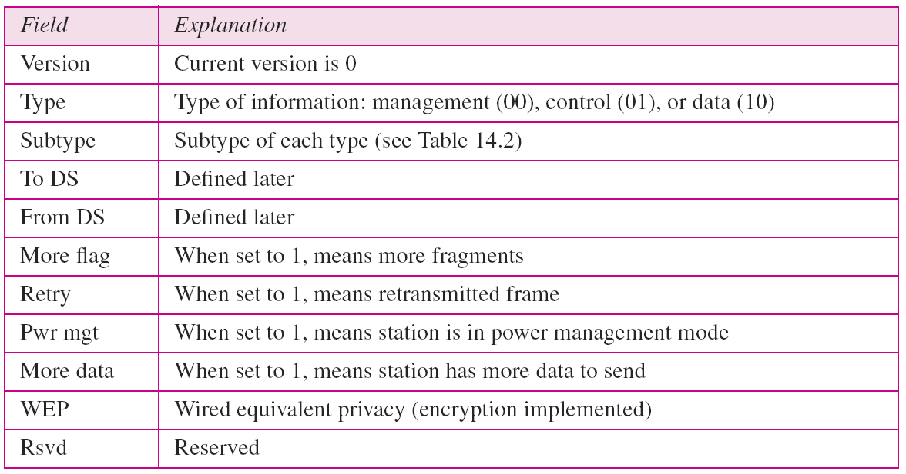
Table 14.1 Subfields in FC field
14.<number>

Slide 22
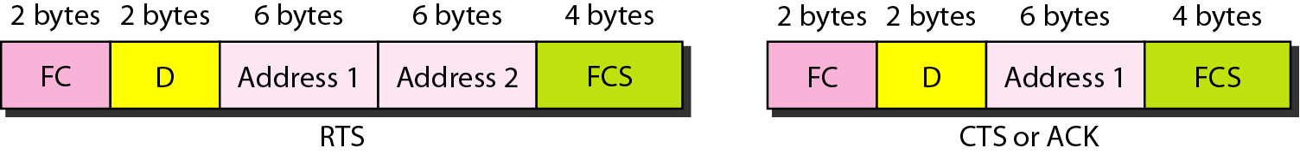
Figure 14.8 Control frames
FC: Frame Control
D: duration of the transmission that is used to set the value of NAV
14.<number>

Slide 23
Frame Types
Three types of frames:
1. Management - used for initial communication between
stations and access points
2. Control - used for accessing the channel (RTS) and
acknowledging frames (CTS or ACK) (See Figure 15-10).
3. Data - used for carrying data and control information
14.<number>

Slide 24
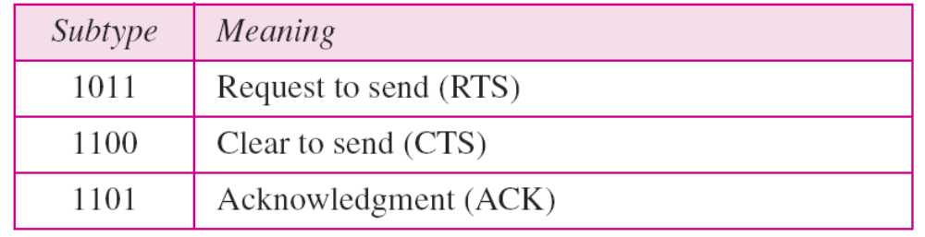
Table 14.2 Values of subfields in control frames
14.<number>

Slide 25
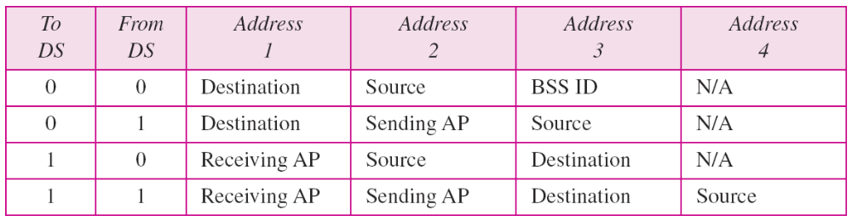
Table 14.3 Addresses
Note: Address 1 is always address of next device
Address 2 is always address of previous device
Address 3 is address of final destination if not defined by Address 1 or Address 3 is address of original source if not defined by Address 2
Address 4 is the original source when the distributed system is also wireless.
14.<number>

Slide 26
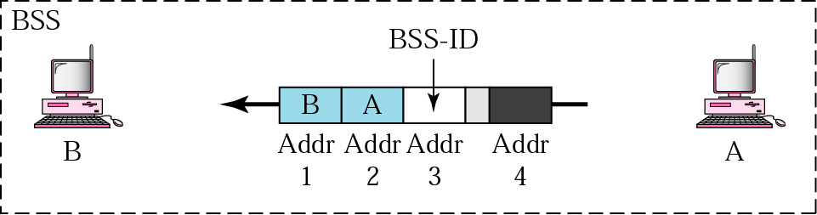
Figure 14-9 Addressing mechanism: case 1
Frame is going directly from one client to another. No
intervening distribution system. To DS = 0, From DS = 0
14.<number>

Slide 27
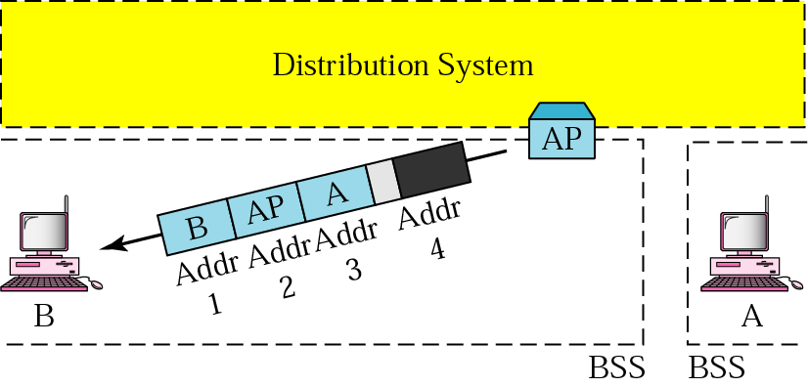
Addressing mechanism: case 2
To DS = 0, From DS = 1 - frame is coming from a DS (Access
Point)
14.<number>

Slide 28
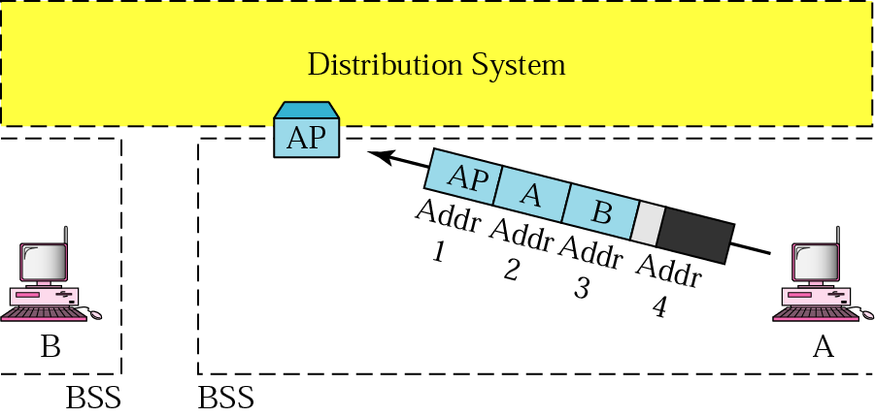
Addressing mechanism: case 3
To DS = 1, From DS = 0 - frame is going to a DS (or AP)
14.<number>

Slide 29
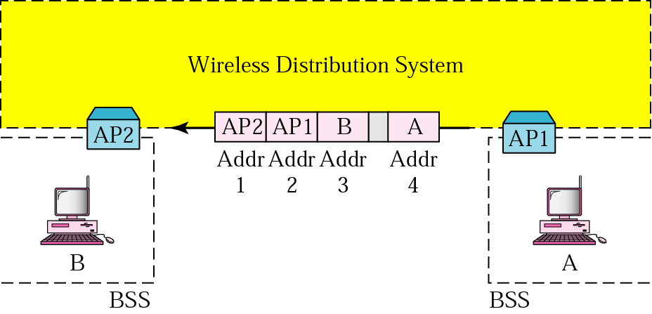
Addressing mechanism: case 4
To DS = 1 and From DS = 1
14.<number>

Slide 30
Wireless network characteristics
Multiple wireless senders and receivers create additional problems (beyond multiple access):
A
B
C
C
A’s signal
strength
C’s signal
strength
B
A
Hidden terminal problem
B, A hear each other
B, C hear each other
A, C can not hear each other
means A, C unaware of their interference at B
space
Signal attenuation:
B, A hear each other
B, C hear each other
A, C can not hear each other interfering at B

Slide 31
IEEE 802.11: multiple access
avoid collisions: 2⁺ nodes transmitting at same time
802.11: CSMA - sense before transmitting
  don’t collide with ongoing transmission by other node
802.11: no collision detection!
  difficult to receive (sense collisions) when transmitting due to weak received signals (fading)
  can’t sense all collisions in any case: hidden terminal, fading
  goal: avoid collisions: CSMA/C(ollision)A(voidance)
A
B
C
C
A’s signal
strength
C’s signal
strength
B
A
space

Slide 32

Figure 14.4 CSMA/CA flowchart
DIFS: distributed
interframe space
SIFS: short
interframe space
14.<number>

Slide 33
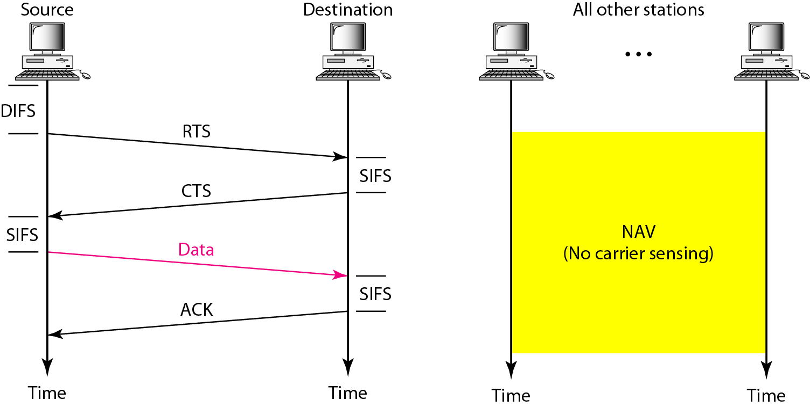
Figure 14.5 CSMA/CA and NAV (Network Allocation Vector)
When a station sends its RTS, it includes a time of how long it needs the medium.
Other stations then set their NAV timer to this time so they don’t transmit.
DIFS: Distributed interframe space; SIFS: short interframe space
14.<number>

Slide 34
IEEE 802.11 MAC Protocol: CSMA/CA
802.11 sender
1 if sense channel idle for DIFS then
  transmit entire frame (no CD)
2 if sense channel busy then
  start random backoff time
  timer counts down while channel idle
  transmit when timer expires
  if no ACK, increase random backoff interval, repeat 2
802.11 receiver
- if frame received OK
return ACK after SIFS (ACK needed due to hidden terminal problem)
sender
receiver
DIFS
data
SIFS
ACK

Slide 35
Avoiding collisions (more)
idea: allow sender to “reserve” channel rather than random access of data frames: avoid collisions of long data frames
sender first transmits small request-to-send (RTS) packets to BS using CSMA
  RTSs may still collide with each other (but they’re short)
BS broadcasts clear-to-send CTS in response to RTS
CTS heard by all nodes
  sender transmits data frame
  other stations defer transmissions
avoid data frame collisions completely
using small reservation packets!

Slide 36
Collision Avoidance: RTS-CTS exchange
A
B
AP
RTS(B)
RTS(A)
reservation collision
RTS(A)
CTS(A)
CTS(A)
DATA (A)
defer
time
ACK(A)
ACK(A)

